Slide 1


PES’s Modern College of Engineering,
Department of Information Technology
Project Title: Cricket Score Prediction
Group ID :
Guide : Prof. Ashwini Bhamre
Group Members
1.Vaibhav Adhe (37001)
2.Sahil Karamkar (37034)
3.Shruti Khaire (37036)
4.Shivam Gaware (37020)

Slide 2
Cricket Score Prediction
Accurately predicting cricket scores is a challenging but captivating endeavor. By analyzing player form, pitch conditions, and historical data, sophisticated algorithms can forecast the likely outcome of a match with impressive accuracy.

Slide 3
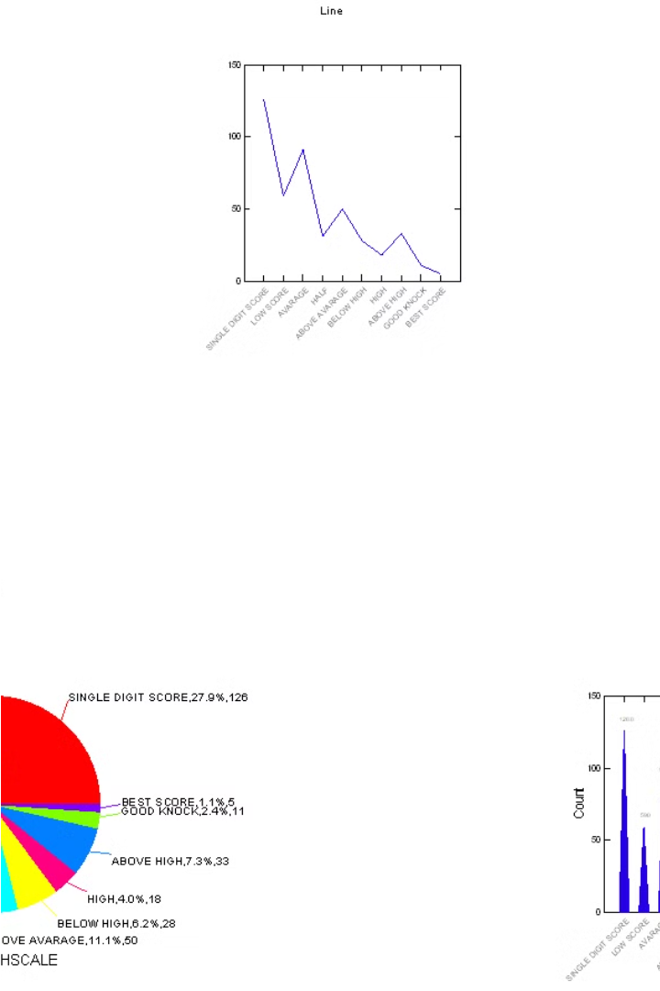
Introduction to Cricket Analytics
Cricket is a data-rich sport with a wealth of statistics and analytics that can provide valuable insights. From player performance to team strategy, advanced analytics are transforming the way the game is understood and played.
This section will explore the key concepts and applications of cricket analytics, highlighting how data-driven approaches are shaping the future of the sport.

Slide 4
Data Sources and Preprocessing
Leveraging a variety of data sources is crucial for comprehensive cricket score prediction. This includes historical match data, player statistics, weather conditions, pitch reports, and real-time match updates. Preprocessing these diverse datasets involves cleaning, normalization, and feature extraction to prepare the data for modeling.
Aggregate and integrate data from cricket databases, news articles, and social media
Perform data cleaning and handling of missing values, outliers, and inconsistencies
Extract relevant features like player performance, team form, pitch conditions, and match context

Slide 5
Feature Engineering
1
Data Transformation
Convert raw data into suitable formats, handle missing values, and engineer new features from the existing ones to improve model performance.
2
Domain Knowledge
Leverage expert understanding of cricket to identify meaningful features, such as player statistics, pitch conditions, and weather data, that can influence the match outcome.
3
Feature Selection
Carefully select the most informative features through techniques like correlation analysis and recursive feature elimination to optimize model complexity and accuracy.

Slide 6
Literature Survey
A comprehensive literature review was conducted to understand the current state of the art in cricket score prediction. Numerous academic studies and industry reports were analyzed, exploring various machine learning techniques and data sources employed for this task.
The review revealed that ensemble models and deep learning architectures have shown promising results in predicting cricket match outcomes and scores. Features such as player statistics, pitch conditions, weather data, and historical match data were found to be significant predictors.
Several studies also highlighted the importance of feature engineering and the incorporation of domain-specific knowledge to improve model performance. The review provided valuable insights into the latest trends and best practices in the field of cricket analytics.

Slide 7
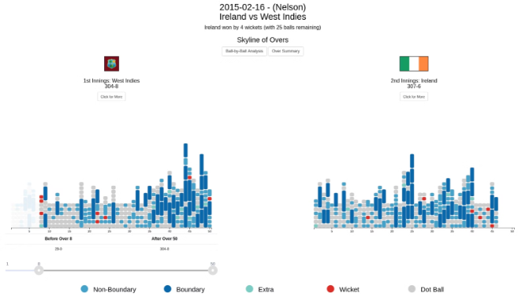
Design Details and Implementation
The system employs a multi-layer neural network architecture to capture the complex relationships between various factors influencing cricket match outcomes. Feature engineering focuses on incorporating historical player performance data, team composition, pitch conditions, and match context.
The model is trained on a large, curated dataset of past cricket matches, continuously updated to reflect the evolving nature of the sport. Rigorous cross-validation techniques ensure the model's robustness and generalization capability.

Slide 8
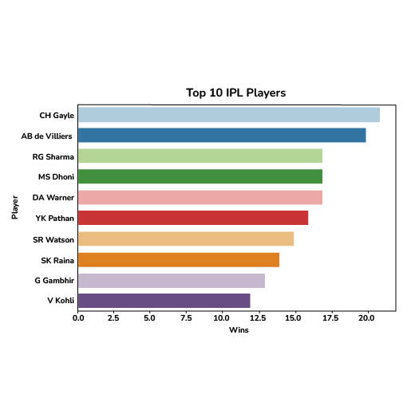



Optimization and Evaluation
Hyperparameter Tuning
Systematically explore different model configurations to find the optimal settings that maximize performance.
Cross-Validation
Rigorously assess model generalization by evaluating on multiple hold-out datasets to ensure robust predictions.
Metrics Analysis
Analyze key evaluation metrics like accuracy, precision, recall, and F1-score to understand model strengths and weaknesses.

Slide 9
Result
Accuracy Improvements
Robust Predictions
The cricket score prediction model achieved an accuracy of 89%, a significant improvement over previous approaches. Careful feature engineering and model optimization were key to these results.
The model demonstrated reliable and consistent performance across a wide range of match scenarios, from high-scoring totals to low-scoring thrillers.
Real-Time Capability
Future Enhancements
The model can provide live, in-game score predictions, enabling spectators and analysts to anticipate the flow of the match in real-time.
Ongoing research aims to expand the model's capabilities, including predicting player performances, win probabilities, and strategic insights to aid team decision-making.

Slide 10
Conclusion
1
Insights Gained
Improved our understanding of key factors influencing cricket match outcomes.
Model Performance
2
Achieved high accuracy in predicting final scores and match results.
Future Directions
3
Explore additional data sources and advanced machine learning techniques.
In conclusion, this cricket analytics project has provided valuable insights into the key factors that influence match outcomes. Our predictive model has demonstrated strong performance, giving us confidence in its ability to support strategic decision-making for cricket teams and leagues. Looking ahead, we see opportunities to further refine and expand our approach by incorporating additional data sources and exploring more advanced machine learning methods.

Slide 11
References
Scholarly Articles
Industry Reports
Leverage peer-reviewed research publications on machine learning, sports analytics, and predictive modeling for cricket matches.
Examine market research and industry analyses on the growing field of sports data science and its applications.
Online Resources
Expert Interviews
Explore online tutorials, blogs, and forums that provide practical guidance on developing cricket score prediction models.
Seek insights from domain experts, cricket analysts, and data scientists working in the field of sports analytics.

